Slide 1
I implement the following image processing feature in the project:
1. Camera Calibration
1.1 Corner detection
1.2 Find the intrinsic matrix
1.3 Find the extrinsic matrix
1.4 Find the distortion matrix
2. AR
3. Pupil detection 3.1 Median Smooth 去除圖片的雜訊
3.2 Canny 邊緣偵測
3.3 HoughCircle + cvCircle 找出圓並將瞳孔標示出來

Slide 2
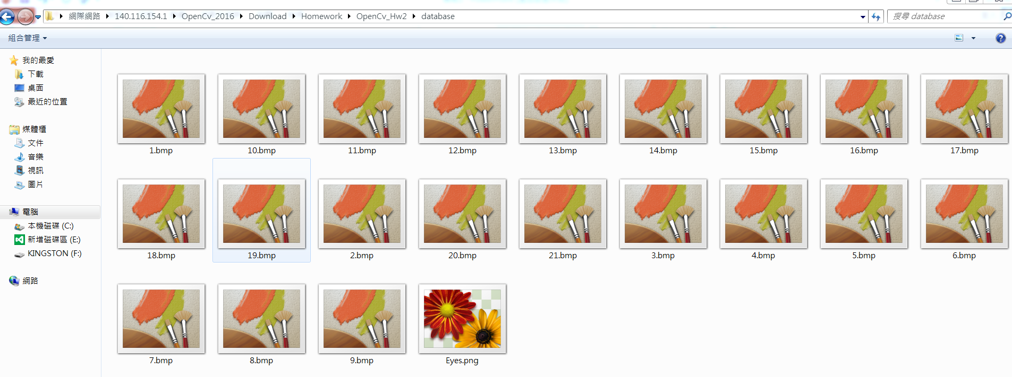
Image Resources
Folder “Database”: includes image files 1.bmp ~ 21.bmp, and Eyes.png
Folder “database”

Slide 3
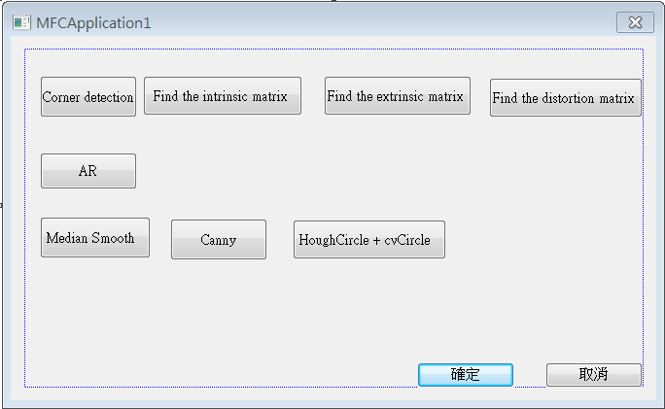
1. Display Format
I use the Visual Studio MFC to create the window to display the image processing features I implement.

Slide 4
2. Camera Calibration
2.1 Corner detection
2.2 Find the intrinsic matrix
2.3 Find the extrinsic matrix
2.4 Find the distortion matrix

Slide 5
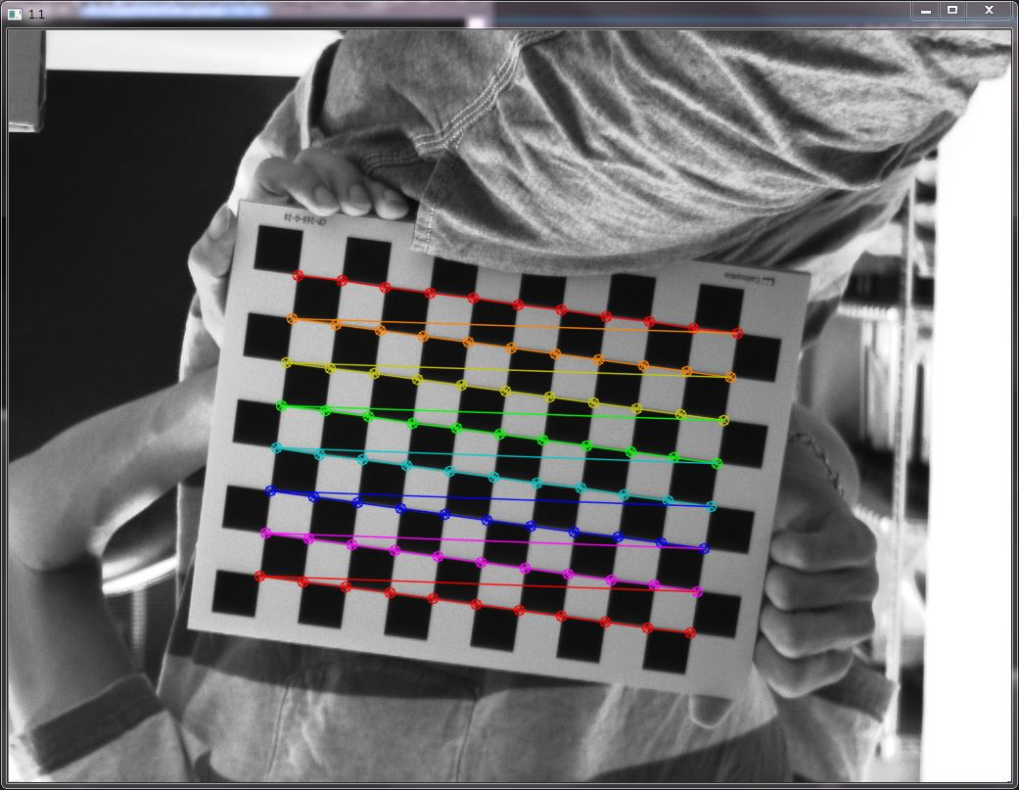
2.1 Corner detection
Find the corners on the chessboard (1.bmp) and draw them.
Click button “1.1” and then show the result.
Hint : cvShowImage(…);
EX:

Slide 6
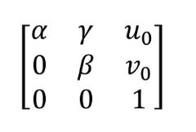

2.2 Find the intrinsic matrix
Find the intrinsic matrix:
Click button “1.2” and then show the result on the console window.
Output format:

Slide 7
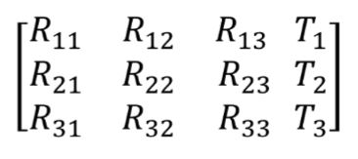

2.3 Find the extrinsic matrix
Find the extrinsic matrix of the chessboard (1.bmp):
Click button “1.3” and then show the result on the console window.
Output format:

Slide 8

2.4 Find the distortion matrix
Find the distortion matrix:
Click button “1.4” and then show the result on the console window.
Output format:

Slide 9
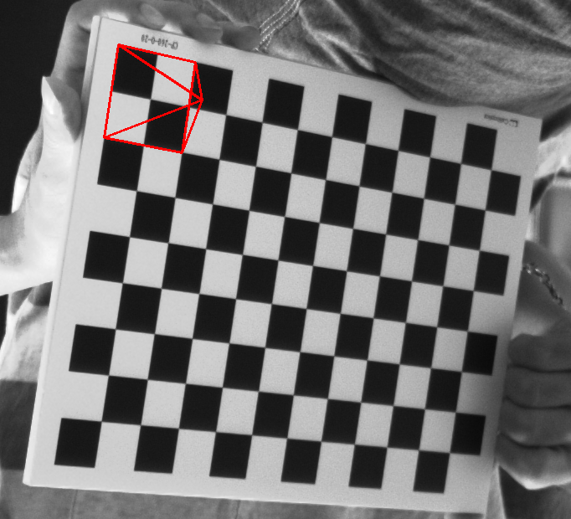
3. AR
1. Draw pyramid on the chessboards images(1.bmp to 5.bmp)
2. Click the button ”2” 開始播放畫上金字塔的圖，每格0.5秒顯示下一張(共顯示五張)
Hint :
Textbook Chapter 11、12
cvLine(…)
3D Object coordinates:
Vertex (0, 0, -2)
Corners(1, 1, 0)(1, -1, 0)(-1, -1, 0)(-1, 1, 0)
(0,0,0)
(0, 0, -2)
(示意影片: 見 FTP 資料夾 hw2 的範例影片 Hw2_Demo.mp4 )
(-1, -1, 0)
(1, -1, 0)
(-1, 1, 0)
(1, 1, 0)

Slide 10
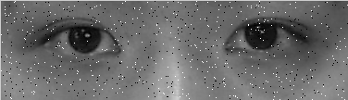
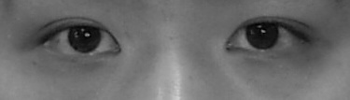
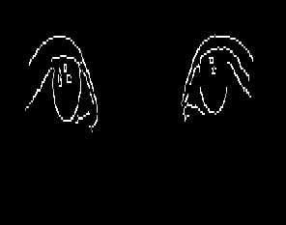
4.Pupil detection
Median Smooth 去除圖片的雜訊並顯示出來
2) Canny 邊緣偵測並顯示出來
3) HoughCircle + cvCircle 找出圓並將瞳孔標示出來

